Slide 1
Tutorial 11: Java
23/24th May

Slide 2
Java
Java is statically typed
Variables cannot change type once declared
Compiler can raise errors before code is run
Strongly typed
Type of a value does not change in unexpected ways
 | Static | Dynamic
Strong | Java | Python
Weak | C | Javascript

Slide 3
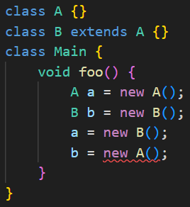
Java types
Variables must be declared with a type
After that, it will only accept that type or its subclasses
Some types can take additional type parameters (e.g. ArrayList<Integer>)
Missing type parameters: allowed for backward compatibility, but compiler gives warning (‘rawtypes’)
Good practice to include, not enforced in CS1010X

Slide 4
Java access modifiers
All classes, variables and methods must have an access modifier
 | private | (default) | protected | public
Same class | Yes | Yes | Yes | Yes
Same package | No | Yes | Yes | Yes
Different package subclass | No | No | Yes | Yes
Different package non-subclass | No | No | No | Yes
**Private: accessible inside the same class only (can be different objects)
Protected: accessible in class and its children (packages not in syllabus)
**Public: accessible anywhere

Slide 5
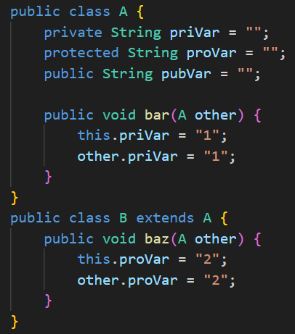
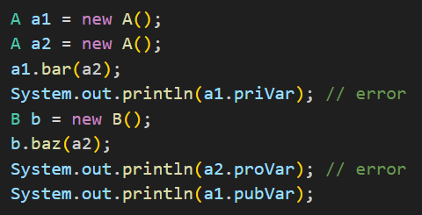
Java access modifiers
^ no access to private and protected outside class
< inside class, access is granted, even if not this object
Syntax for declaring variables:
[access modifier] [type] [varName];

Slide 6
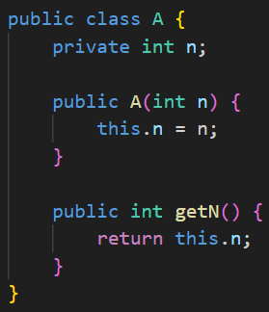
Java classes
Syntax:
[access modifier] class [className] {
[attributes]
[methods]
}
Highest-level class: Object

Slide 7
Java classes - constructor
Method with same name as the class
Used to create a new instance of the class
Default constructor:
public className( ) { }
public className( ) { super( ); }
- Not used if any constructor is explicitly declared!

Slide 8
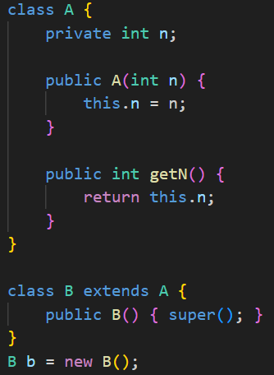
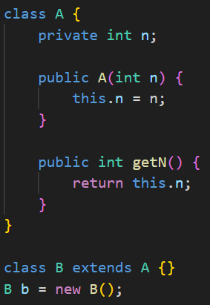
Java classes - constructor
Does this compile?
No! A only has 1 constructor, which needs 1 input

Slide 9
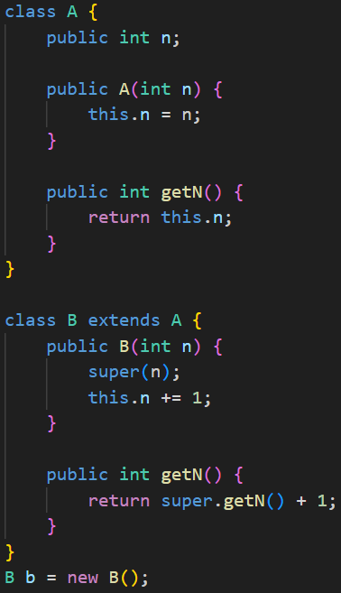
Java classes - super
Constructor of subclass: first line must call super
Subclass can call methods in the superclass with super.methodName( )
*provided there is access

Slide 10
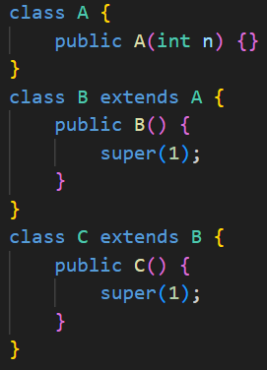
Java classes - super
Does this compile?
No, super only goes up 1 level
B has only 1 constructor which takes 0 arguments

Slide 11
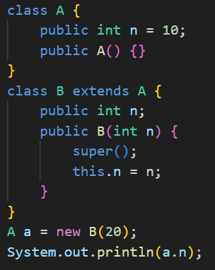
Attribute finding
What is the value printed?
Compile-time type (CTT) of a: A
Run-time type (RTT) of a: B
Java starts searching for n from CTT(a)
Take the n declared in class A → print 10
Attribute finding is based on CTT only
Method finding uses dynamic binding, which uses a mix of CTT and RTT

Slide 12
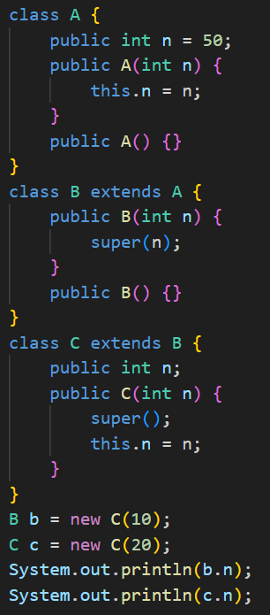
Attribute finding
Look for attribute starting from CTT
If attribute not found, go to super(CTT)
If attribute still not found in any superclass, throw error

Slide 13
Attribute finding
Look for attribute starting from CTT
If attribute not found, go to super(CTT)
If attribute still not found in any superclass, throw error
b.n → 50

Slide 14
Attribute finding
Look for attribute starting from CTT
If attribute not found, go to super(CTT)
If attribute still not found in any superclass, throw error
b.n → 50
c.n → 20

Slide 15
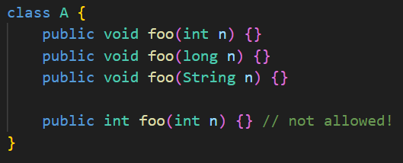
Method overloading
Method signature:
name
number of parameters
types of parameters
order of parameters
Can have methods with same name, as long as method signature is different

Slide 16
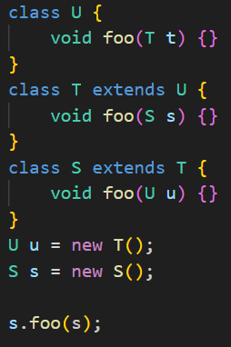
Dynamic binding
Which method should be run?
Hierarchy: S <: T <: U (<: means “is a subtype of”)
Compile-time step
Step 1: Get all accessible methods of object s
foo(T), foo(S), foo(U)
Step 2: Filter all compatible methods for input s
Step 3: Record method descriptor of most specific method for input s
void foo(S)
Method descriptor: method signature + return type

Slide 17
Dynamic binding
Method descriptor: void foo(S)
Run-time step
Step 4: Start from RTT of object, find the first matching method descriptor
class S: no match, class T: match!
void T::foo(S) is run

Slide 18
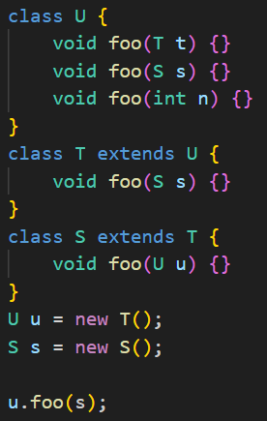
Dynamic binding
Compile-time step:
Get all accessible methods of u foo(T), foo(S), foo(int)
Filter compatible methods for input s foo(T), foo(S)
Record most specific method descriptor for input s void foo(S)
Run-time step:
4. Start from RTT(u) = T, find matching method descriptor
void T::foo(S)

Slide 19
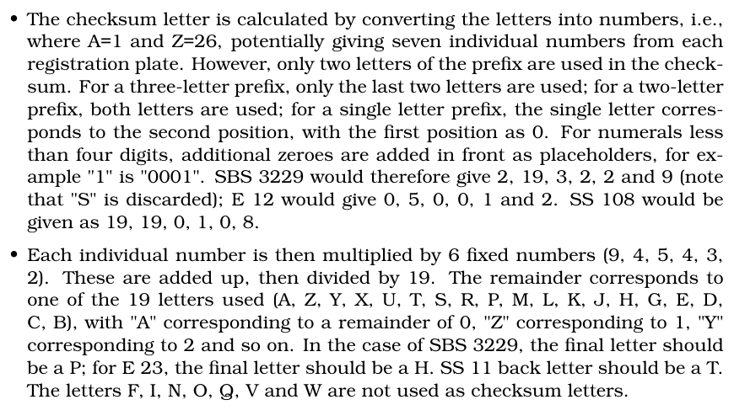
Q1: Question Analysis
What is the key information?
Converting letters into alphabet index
Converting remainder into checksum using list specified

Slide 20
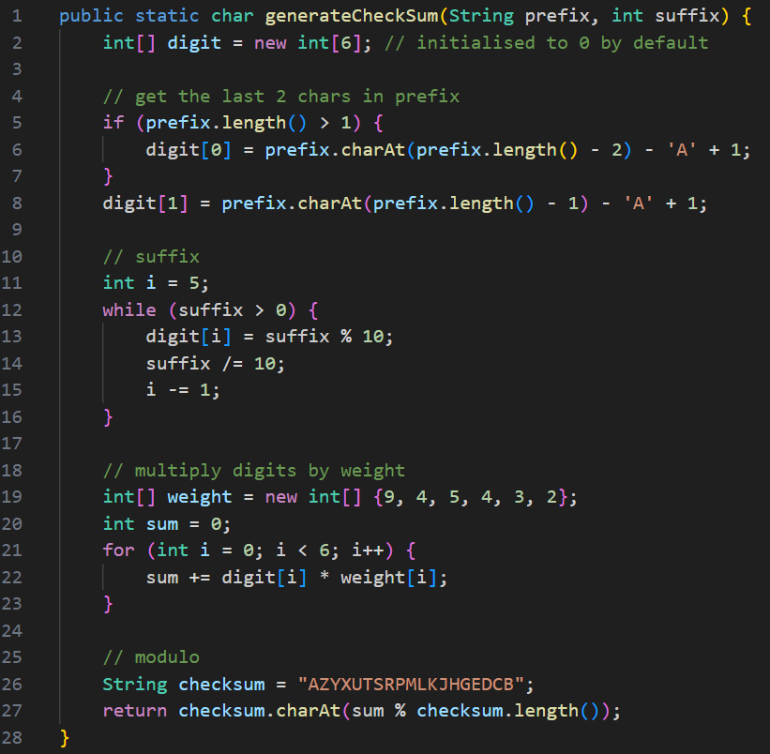
Q1: Answer

Slide 21
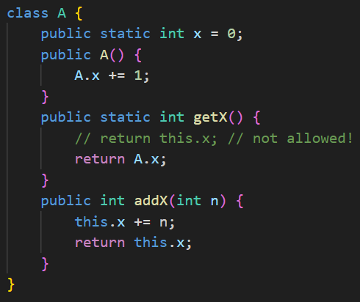
Static
No instance needed to call static methods, call using the class name
[ClassName].staticMethod( );
Static methods cannot access non-static fields
Static fields: 1 copy shared by all objects in the class
A a1 = new A( );
A.getX( ) → 1
A a2 = new A( );
A.getX( ) → 2

Slide 22
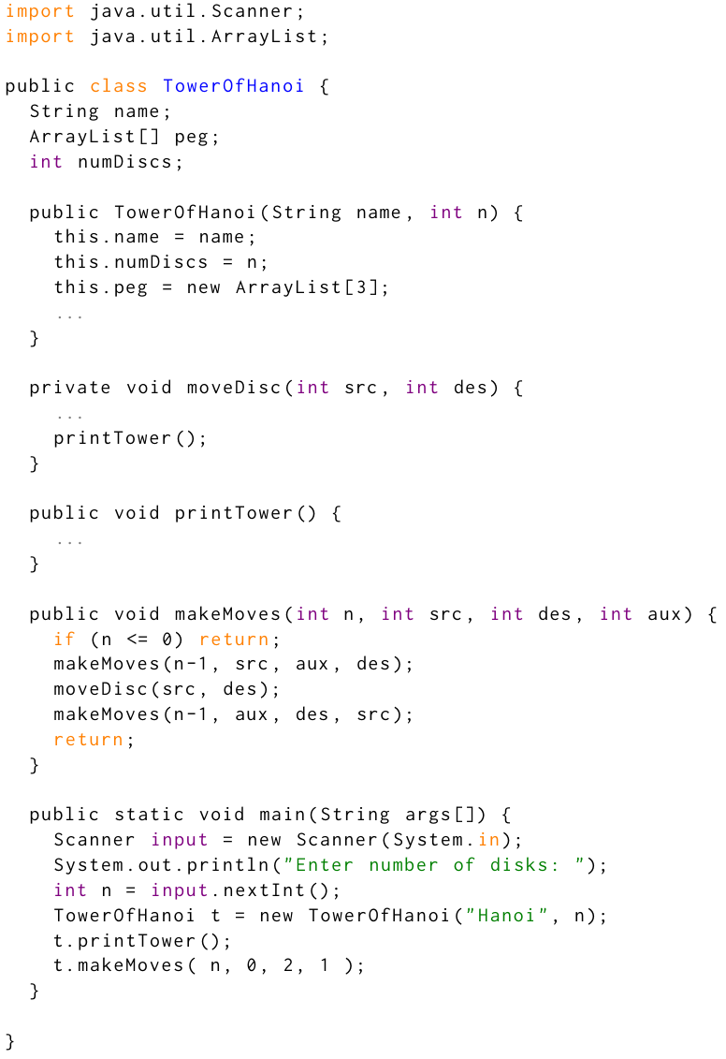
Q2: Question Analysis
What is the key information?
Components of Tower of Hanoi game
Process of the game

Slide 23
Q2(a): Answer
Peg → ArrayList
Disc → int
makeMoves → recursive calls to move nth disc

Slide 24
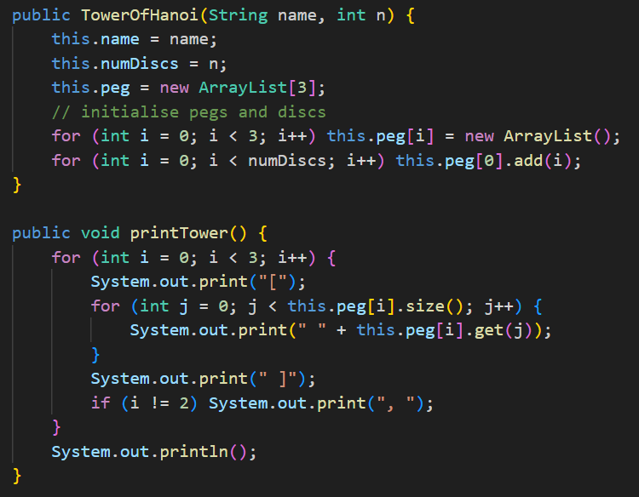
Q2(b): Answer

Slide 25
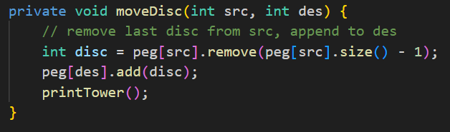
Q2(c): Answer

Slide 26
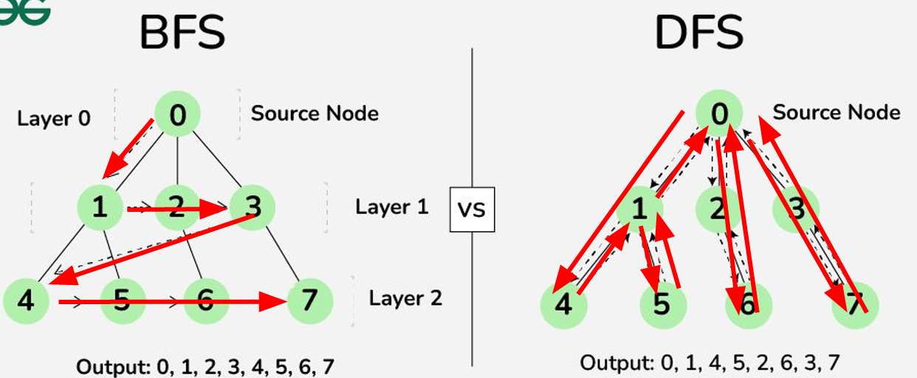
Bonus: BFS/DFS
2 ways of traversing a graph
Breadth-first search: visit nodes by layer/distance from source node
Implemented with a queue
Depth-first search: visit a subtree completely first
Implemented with stack / recursion

Slide 27
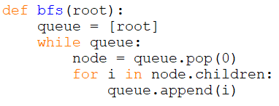
Bonus: BFS
Structure of BFS:
queue with root node
while loop checking queue length
dequeue oldest node
enqueue all its children
Applications of BFS:
Finding shortest path
Counting components in a disconnected graph

Slide 28
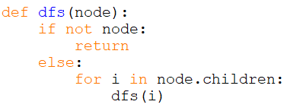
Bonus: DFS
Structure of DFS:
If there is no node, return None
Else, recursively search all its children
Applications of DFS:
Topological sort
Counting strongly connected components
Pre/in/post order traversal
Problems that require backtracking

Slide 29
Extra Question 1: Count islands
Count the number of islands on a map
Each island is an orthogonally connected group of land cells (X)
Water cells are O
[[X, X, X, O, X],
[O, O, O, X, X],
[O, O, O, O, O],
[X, X, X, X, O]]
3 islands

Slide 30
Ex 1: Problem Analysis
Islands are surrounded by O, or the edge of the map
After we find an island, we should mark all the adjacent land cells to avoid double-counting
Also need to check every cell for islands
Use for loop to iterate through all cells
Unvisited land cell → use BFS to explore all adjacent land cells
Keep track of cells we have visited (new 2D array / mark on original array)

Slide 31
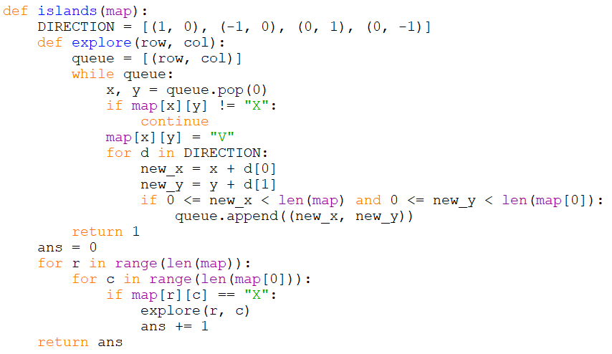
Ex 1: Answer

Slide 32
The end
Good luck for PE and finals!

